Slide 1
Wholesale Distribution in Toronto
Using Data Science to start a new Wholesale Distribution venture

Slide 2
So you want to start a new Wholesale Distribution venture…
Wholesale Distribution can be an extremely successful and lucrative business venture when done well.
One of the most important factors to consider when starting a new Wholesale Distribution business is selecting an appropriate product to supply.
What if Data Science was used to understand the nature of retailers in proximity of your new Warehouse? Understanding what kind of retailers surround you would be useful in selecting a product to supply that would be in high demand.

Slide 3
Business Problem and Data Science Project
Business Problem: what type of product should a new Wholesale Distribution business supply in the city of Toronto?
How Data Science will help: Data from Wikipedia and Foursquare will be utilized to understand the types of retailers in every Neighborhood in Toronto. Knowing what retailers dominate the majority of Toronto’s footprint will assist in solving the Business Problem.

Slide 4
Data Acquisition and Wrangling
Neighborhoods: A list of neighborhoods in Toronto and their respective zip codes were scraped from Wikipedia using the BeautifulSoup package in Python.
Zip code/latitude/longitude combinations for each Neighborhood were called in the Foursquare API to obtain venues in each Neighborhood.
Pandas and numpy packages in Python were used to analyze venue data and determine which type of venues were most frequent for each Neighborhood. This will determine the best product to supply for a new Wholesale Distribution venture.
Wrangling: Throughout this process, exploratory data analysis was used to check for incorrect formatting, duplicates, and data was cleaned accordingly.

Slide 5

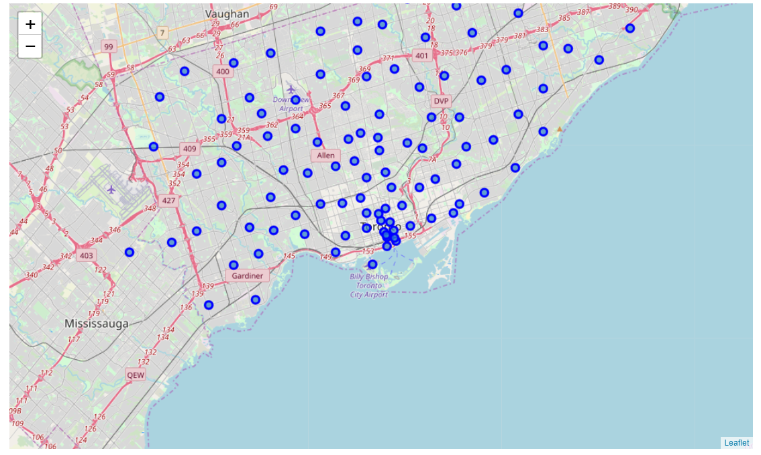
Neighborhoods in Toronto were scraped from Wikipedia and plotted using their Latitude and Longitude.

Slide 6
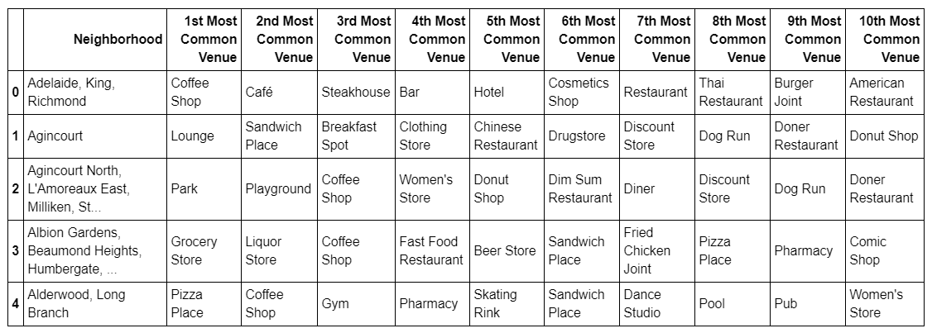
2253 unique venues were found!
Using the Foursquare API, data was analyzed to determine what types of venues are most frequently occurring in each Neighborhood found on the previous map (sample of 4 out of 103 neighborhoods).

Slide 7
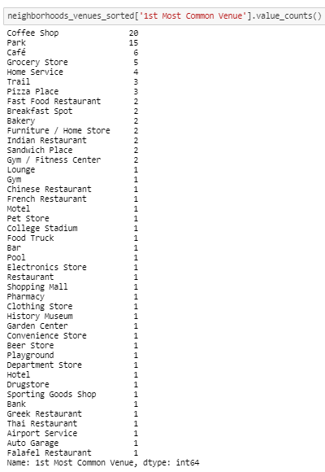
Using Pandas and Numpy packages in Python, the previous dataframe was analyzed to determine how many times each type of venue appeared as the ‘1st most common type of venue’ among all the Neighborhoods in Toronto.

Slide 8
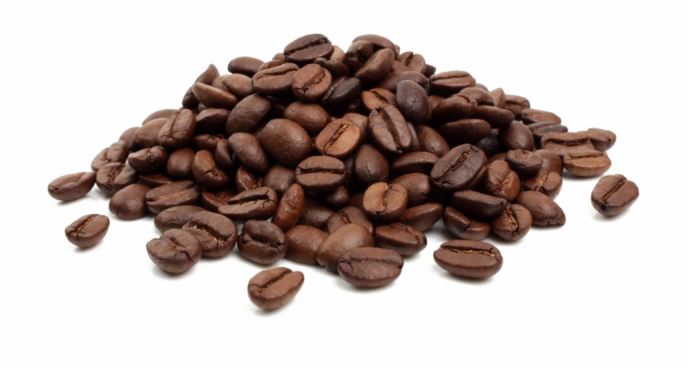
Conclusions
Coffee shops more frequently than other venues were the 1st most frequently occurring venue in all Toronto Neighborhoods. (Cafes were in 3rd place for this spot).

Slide 9
Future Direction and Other Considerations
Next step: plotting all the coffee shops on a map to determine optimal location for a warehouse.
Considerations: this would not take into account optimal ROI; there may possibly be other products to supply for less frequently occurring types of retailers that provide a higher ROI. This is something to consider.

